Slide 1
Analytical Services Internship
Complex Universe of Data

Slide 2
DATA GROWTH might be
HIGHER then Bay Area
POPULATION GROWTH
For 54 years phrase Garbage In Garbage Out has been in existence…

Slide 3
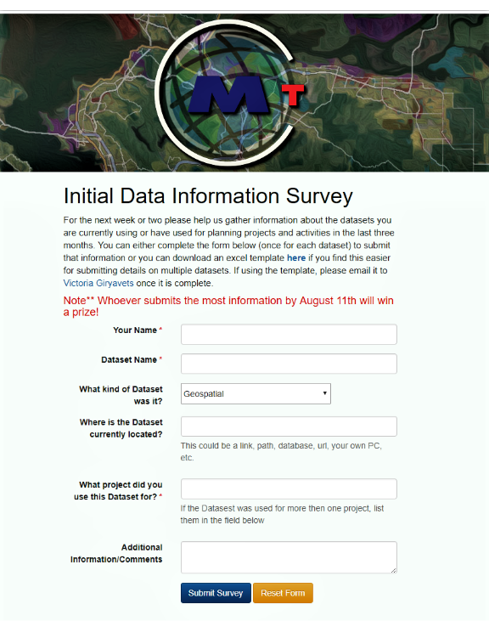
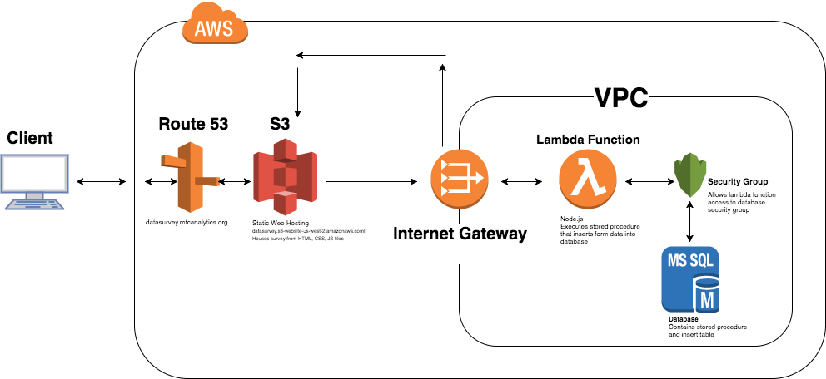
Investigation, or what is commonly know as “Gathering Business Requirements”

Slide 4
Less then 50% participation
Web form
Excel Template
Email
In-Person Interview
“Drive-by”

Slide 5
High volume of existing data
Heavy volume of existing tasks
Low Priority
Skepticism
Lack of clarity in purpose
What if I told you that you can save half of a million dollars by doing thorough inventory of your data

Slide 6
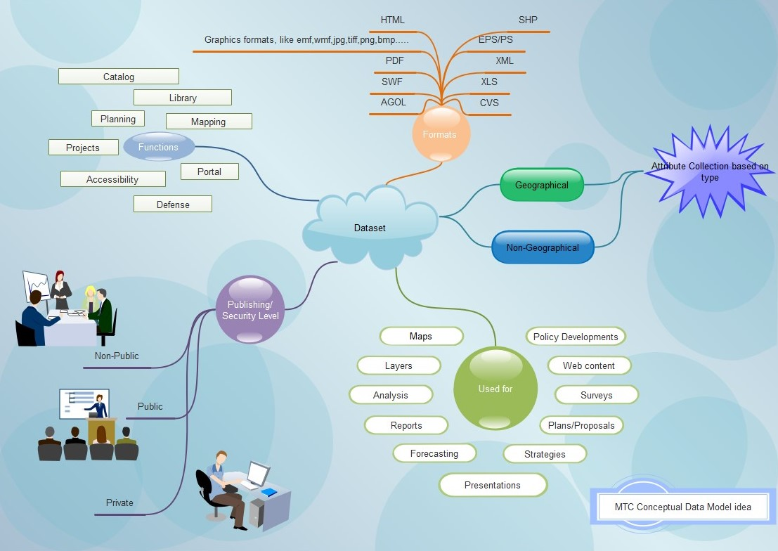
Visualizing Information

Slide 7
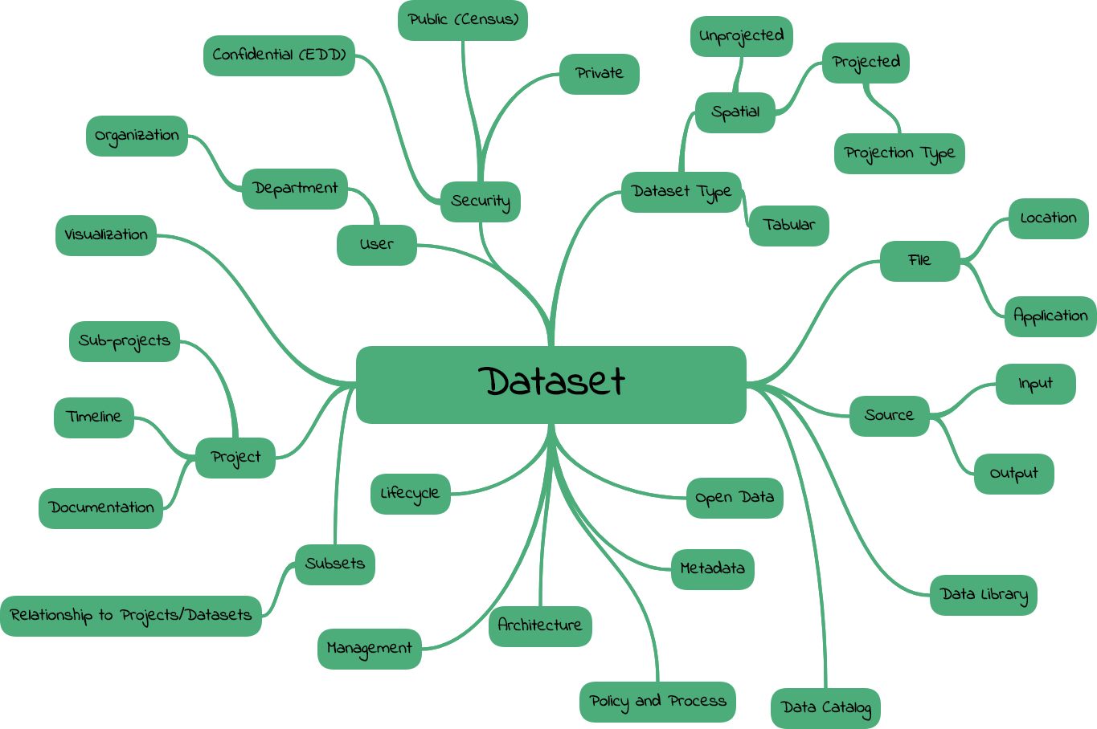

Slide 8
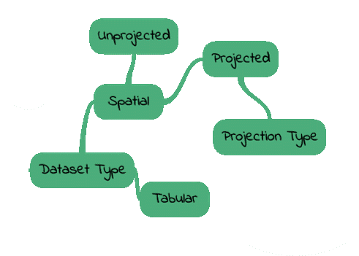
Conceptual Concentration
With the time, availability and complexity constraints – concentrate on high level conceptual design for the data model

Slide 9
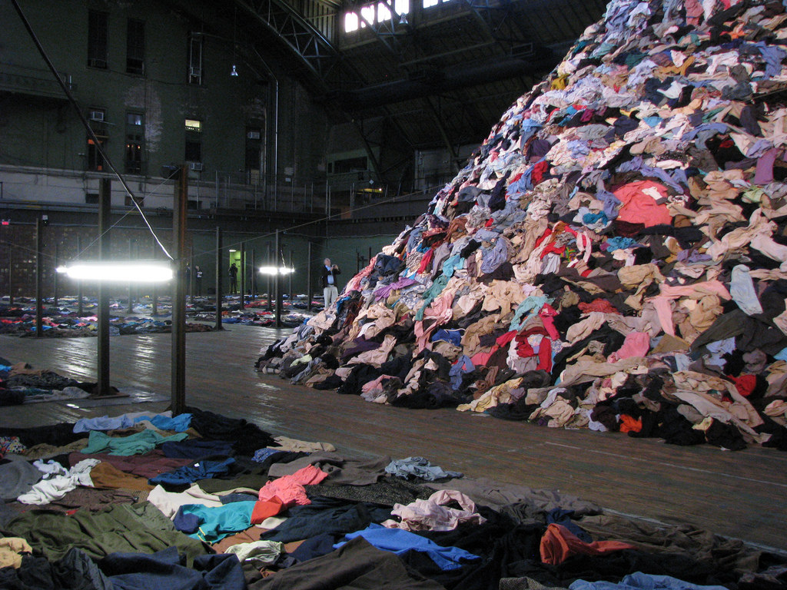

Closet Full of “Data”
Process

Slide 10
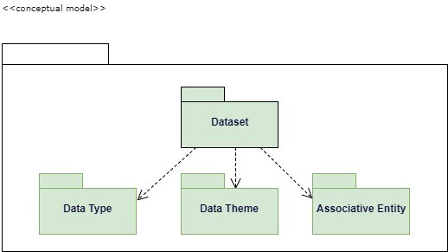
High Level Conceptual Model

Slide 11
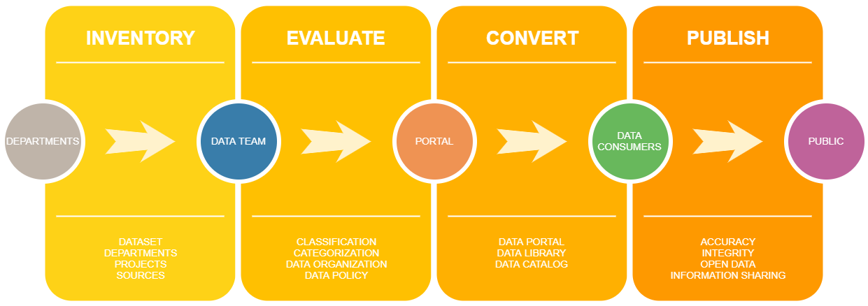
DONE
Gather business requirements
Conceptual Data Model
Left to do
Develop a logical data model
Develop physical data model
Test Data model
Dataset Submission Form

Slide 12
Bay Area Metro Smart Data
Comprehensive Data Governance
Audit
Smart Data Tracking
and Publishing

